Slide 1
Introduction to GAN
Generative Adversarial Networks

Slide 2
Outline
Intuition
Definition
Architecture
Optimization
Applications
References

Slide 3
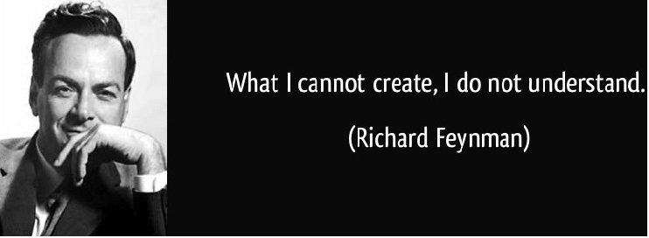
Intuition

Slide 4
Definition
Generative
Learn a generative model: probability distribution function p_{data}(x)
Can generate new data samples
Adversarial
Base on the minimax two-player game framework
Generator vs Discriminator
Networks
Use Deep Neural Networks: y = f(x)

Slide 5
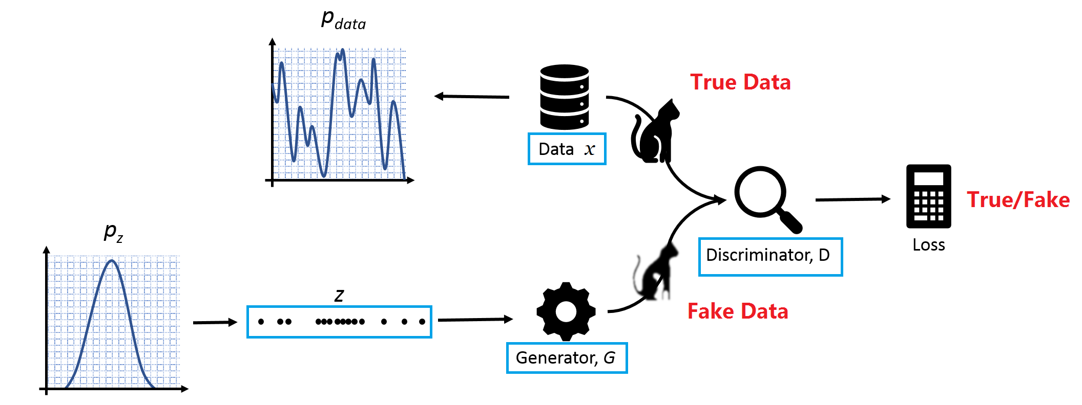
Architecture
x: data
z: some random noise
z: latent representation of data

Slide 6
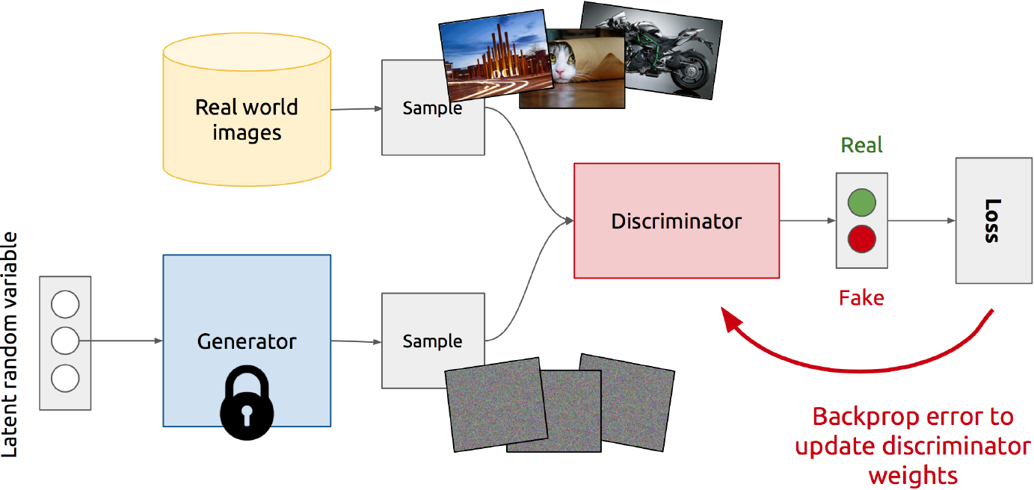
Optimization
Training Discriminator

Slide 7
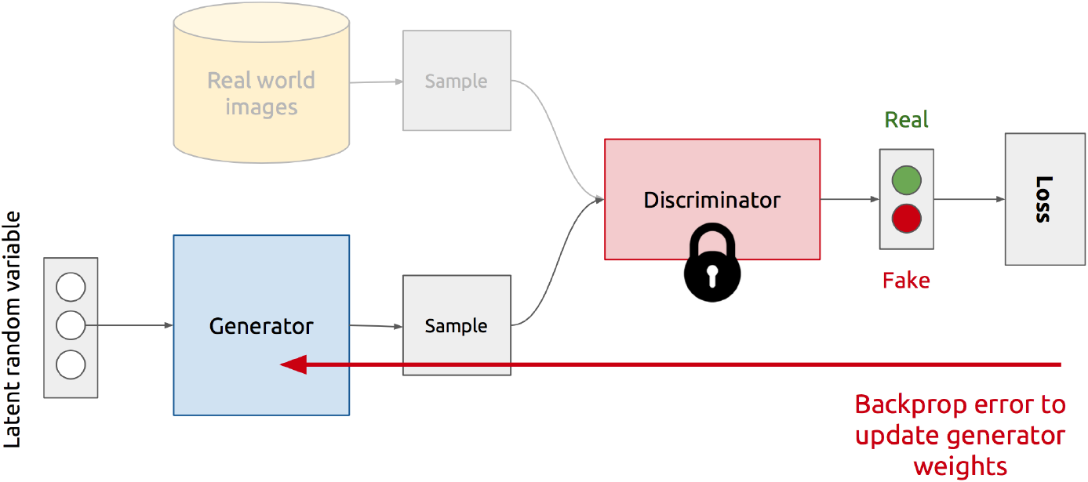
Optimization
Training Generator

Slide 8
Optimization
Adversarial training: G vs D
Adversarial

Slide 9
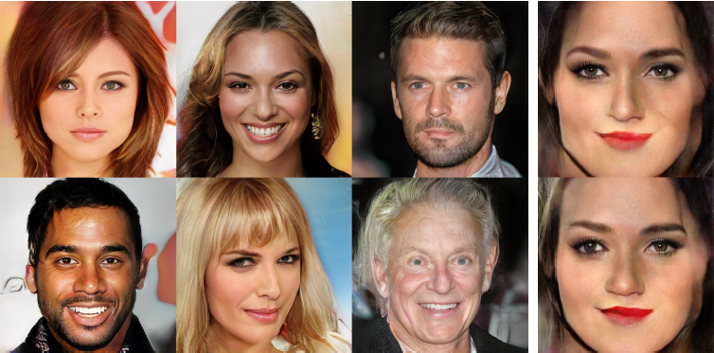
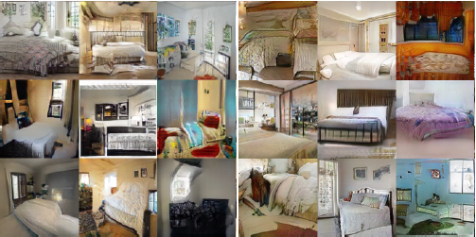
Applications Progressive GAN

Slide 10
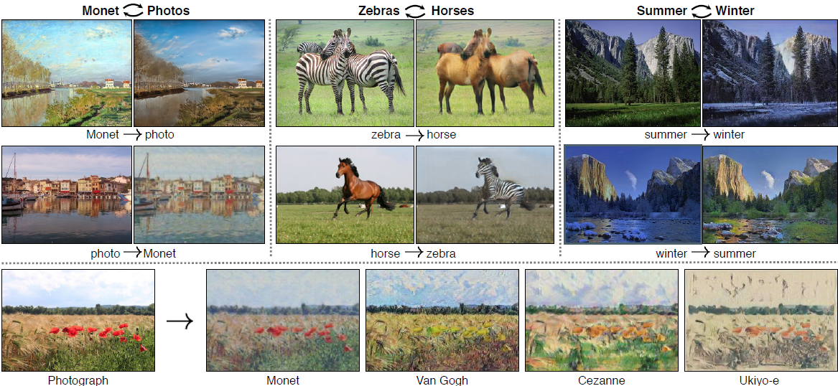
Applications Cycle GAN

Slide 11
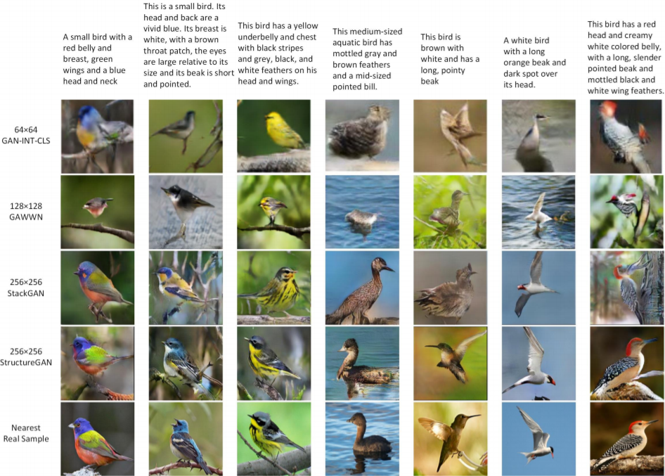
Applications Deep Attention GAN

Slide 12
References
Original GAN Paper
Tutorial of GAN
Introduction to GAN with codes in TensorFlow
Online Book: Neural Networks and Deep Learning

